Slide 1


Future-Proofing Retail: Walmart's Quarterly Sales Forecast with SAS
OPIM-5671- Data Mining & Business Intelligence
Time Series Forecasting Project
Team 4
Pratik More
Date: 19th Feb 2024
Professor: Sudip Bhattacharjee
Notes:
Good afternoon everyone.
Picture this: you're in a Walmart store and all the aisles and shelves are stocked with everything from fresh apples to the latest electronics.
Now, imagine the challenge of predicting exactly what will fly off these shelves in next quarter. That's our story today: 'Forecasting Walmart's Sales'.
We're a Team of 5 people: <team members> and we aim to
1) address this challenge of TimeSeries Forecasting using SAS
2) and offer valuable business insights for strategic decision-making

Slide 2
Problem Statement
To develop a predictive model that accurately forecasts weekly sales for a Walmart store by taking into account historical sales data and other non-intuitive predictive parameters including temperature, fuel prices, unemployment rates in the state, holidays and Consumer Price Index (CPI) information.
Page 2
Notes:
Walmart faces a complex challenge in forecasting sales,
dealing with numerous variables such as historical data, economic indicators, and external factors like weather and fuel prices, the effects of holidays and events on consumer behavior.
Traditional forecasting methods have not been fully successful in managing these complexities, leading to inventory and customer satisfaction issues.
Therefore, Our aim is to move beyond these methods by using SAS analytics to create a forecasting model
that accounts for these variables, giving Walmart a competitive advantage.

Slide 3
Relevance and Impact
Optimize Inventory
Enhancing Operational Efficiency
Staffing & Strategic Planning
Page 3
Notes:
The significance of our project goes beyond academic research.
For a retail store, accurate forecasting is crucial for transforming operations.
It enables:
optimized inventory,
efficient staffing,
effective marketing,
and strategic planning
Through accurate forecasting of the sales, we can optimize inventory in different store locations.
Our forecasts can be used to improve operational efficiency and profitability by aligning stock levels with forecasted demand.
Using the forecasts, we can improve staffing schedules
to ensure adequate customer service during peak and off-peak seasons
and make decisions on promotions and pricing strategies based on anticipated sales trends.
Now, let's dig deep into the data!

Slide 4
Data Description
Parameter | Description
Date | The Week of Sales. It is in the format of dd-mm-yyyy. The date starts from 05-02-2010
Weekly_Sales | The sales of the store in the given week
Holiday_Flag | If the week has a special Holiday or not. 1 - The week has a Holiday 0 - Fully working week
Temperature | Average Temperature of the week in the area
Fuel_Price | Price of the Fuel in the region
CPI | Customer Price Index
Unemployment | Unemployment rate of the region
Data Source: https://www.kaggle.com/datasets/varsharam/walmart-sales-dataset-of-45stores
Page 4

Slide 5
Model Building & Selection Criteria
45 Total Stores categorized into 3 distinct groups based on sales trend : i) Increasing ii) Decreasing iii) Constant
Models Considered
ARIMA, ARIMAX and Exponential Smoothening
Best Fit
We assess how well each model fits the historical sales data, evaluated using MAPE
Parsimonious
We favors simpler models with fewer parameters to achieve similar levels of accuracy, using SBC and AIC
Unbiased Forecasts
We ensure forecasts are neither systematically over nor under the actual values.
Domain Applicable
We make sure our models make sense in the context of retail sales forecasting
Metrics
Best Fit, MAPE, AIC and SBC metrics
Data Pre-processing
02
Time Series Exploration
01
03
Model Building in SAS
04
Model Evaluation & Selection
Page 5
Notes:
As per our initial analysis, we found that all 45 stores exhibited one of the three trends and based on the trend we formed clusters of the stores and then selected the best model for the cluster

Slide 6
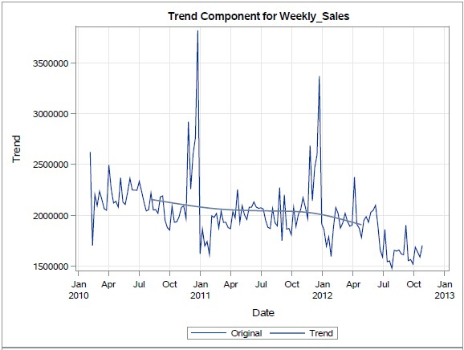
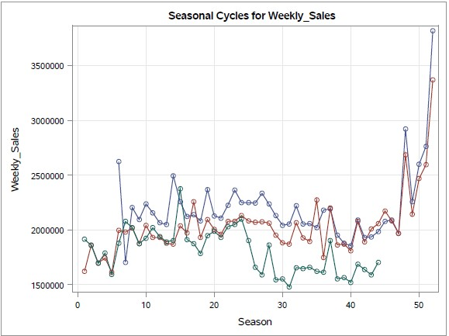
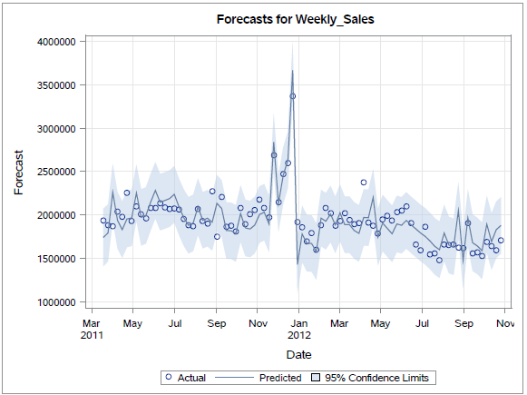
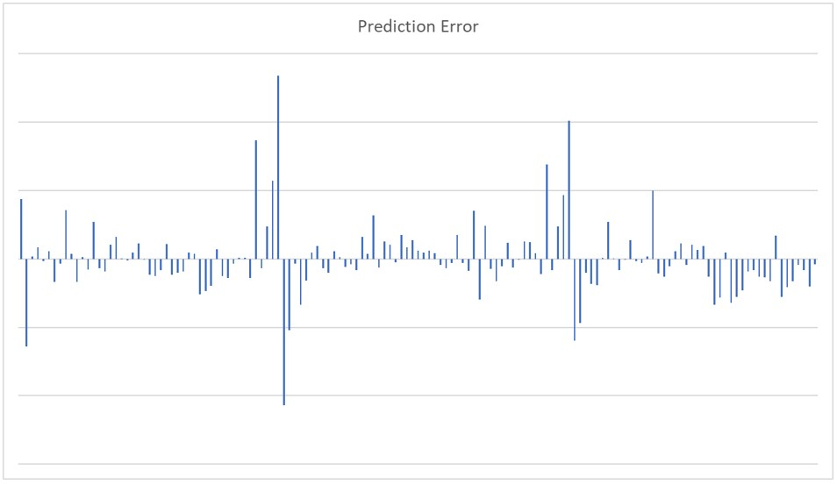
Model 1
 | ARIMAX | WMM
AIC | 2289 | 2748
SBC | 2301 | 2745
MAPE | 7.98 | 15.98
RMSE | 294893 | 202080
ARIMA(0,0,1)(0,1,0)
Decreasing Trend
Page 6

Slide 7
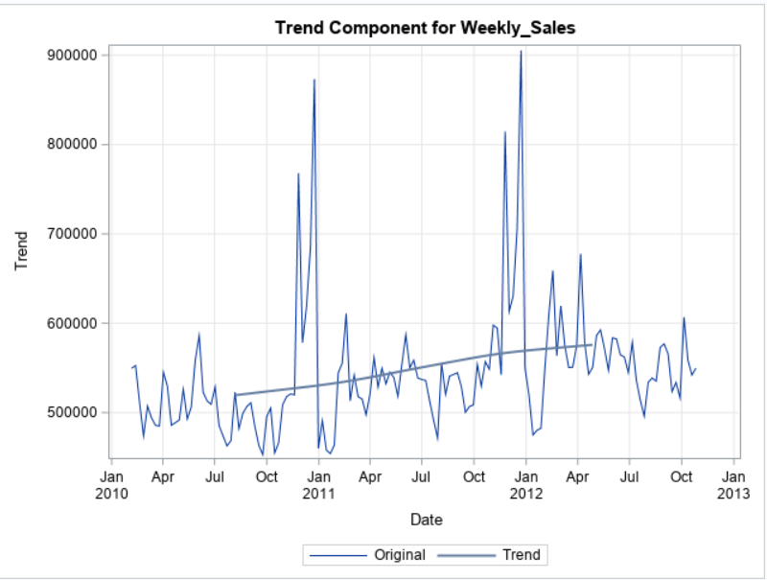
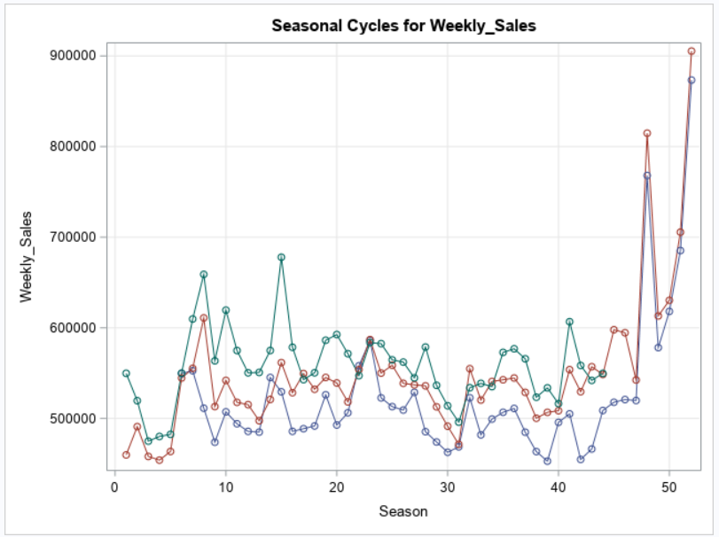
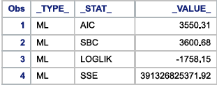
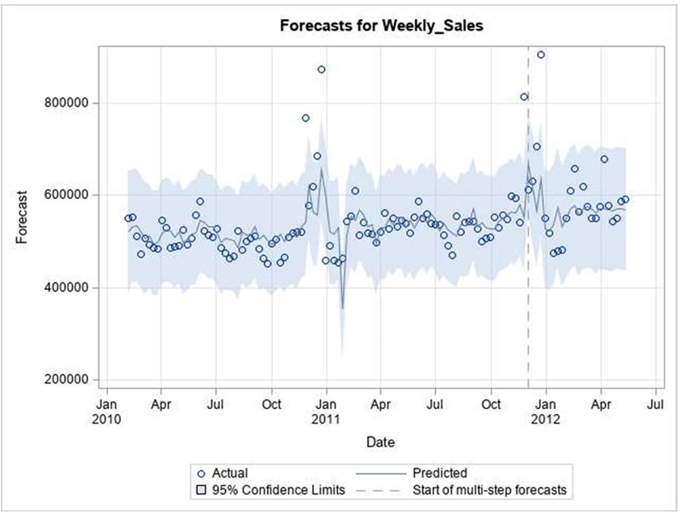
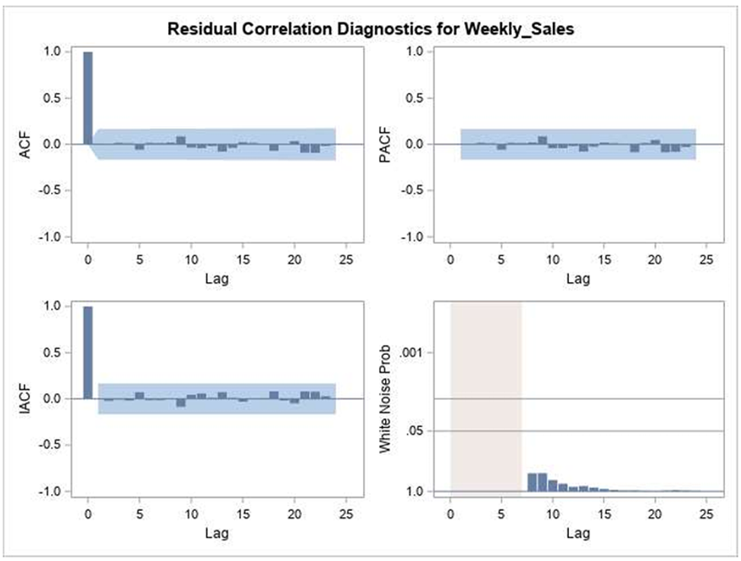
Model 2
ARIMA (5,0,2)
Increasing Trend
Page 7

Slide 8
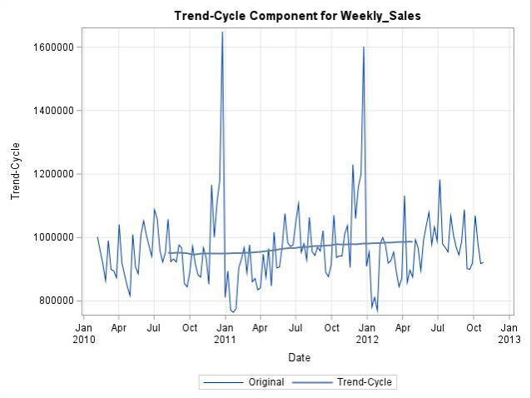
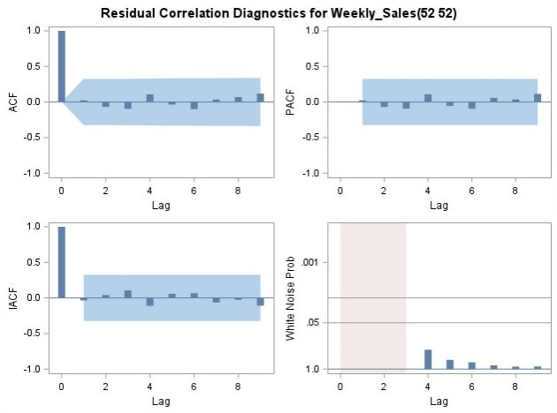
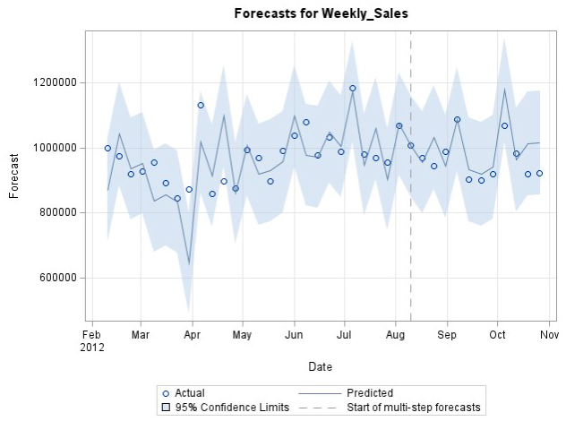
Model 3
MODELS | SBC | AIC
MA Model | 4172.83 | 4169.87
EXPONENTIAL ADDITIVE | 2700.79 | 2695.06
ARIMAX (1,1,3) | 2229.95 | 2207.45
ARIMA (1,1,3) | 2222.38 | 2209.88
ARIMA (2,2,3) | 976.17 | 969.62
ARIMA (2,2,3)
Flat Trend
Page 8

Slide 9
Results and Insights
3 different models for 3 different trends.
Good Model fit for Decreasing Trend and Constant Trend.
Not a good fit for Increasing Trend which suggests few other variables might impact the forecast.
Use the models to plan the staff routines.
Use the models to plan stock maintenance and deliveries for the stores.
Recommendation: Need to look for more related variables which could impact the weekly sales.
Page 9

Slide 10

“The idea that the future is unpredictable is undermined everyday by the ease with which the past is explained.”
Thank You
Do you have any questions?
—Daniel Kahneman
Page 10

